Slide 1



Curriculum Information for Website
Physical Education

Slide 2
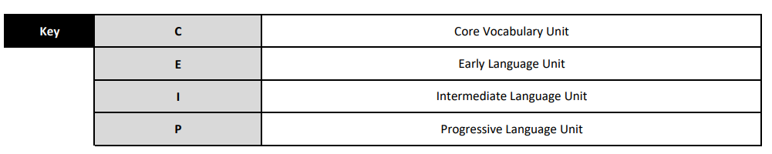
United Curriculum

Slide 3
Language Angels Curriculum Map: MFL
 |  | Year 4
 | Year 3 | Year 4 | Year 5 | Year 6
Autumn 1 | Phonics 1 © I'm Learning French (E) | Phonics 2 (C) Seasons (E) | Phonics 3 (C) The Date? (I) | Recap Phonics 3 Introduce Phonics 4
 |  |  |  | Around Town (P)
Autumn 2 | Animals (E) | Vegetables (E) | What is the weather (I)
Spring 1 | Musical Instruments (E) | Presenting Myself (I) | Do you have a pet? (I) | At School (P)
Spring 2 | I am able (E) | Family (I) | My home (I) | The Weekend (P)
Summer 1 | Fruits (E) | In the Classroom (I) | The Olympics (I) | Healthy Lifestyles (P)
Summer 2 | Ice creams (E) | At the tea room(I)I) IN CLASSROOM THE CLASSROOM | Clothes (I)
 |  |  |  | The Planets (P)

